Slide 1

Emotions
What are emotions ?
Type of emotions
What a lack of emotion can lead to?
How to deal with emotions ?

Slide 2
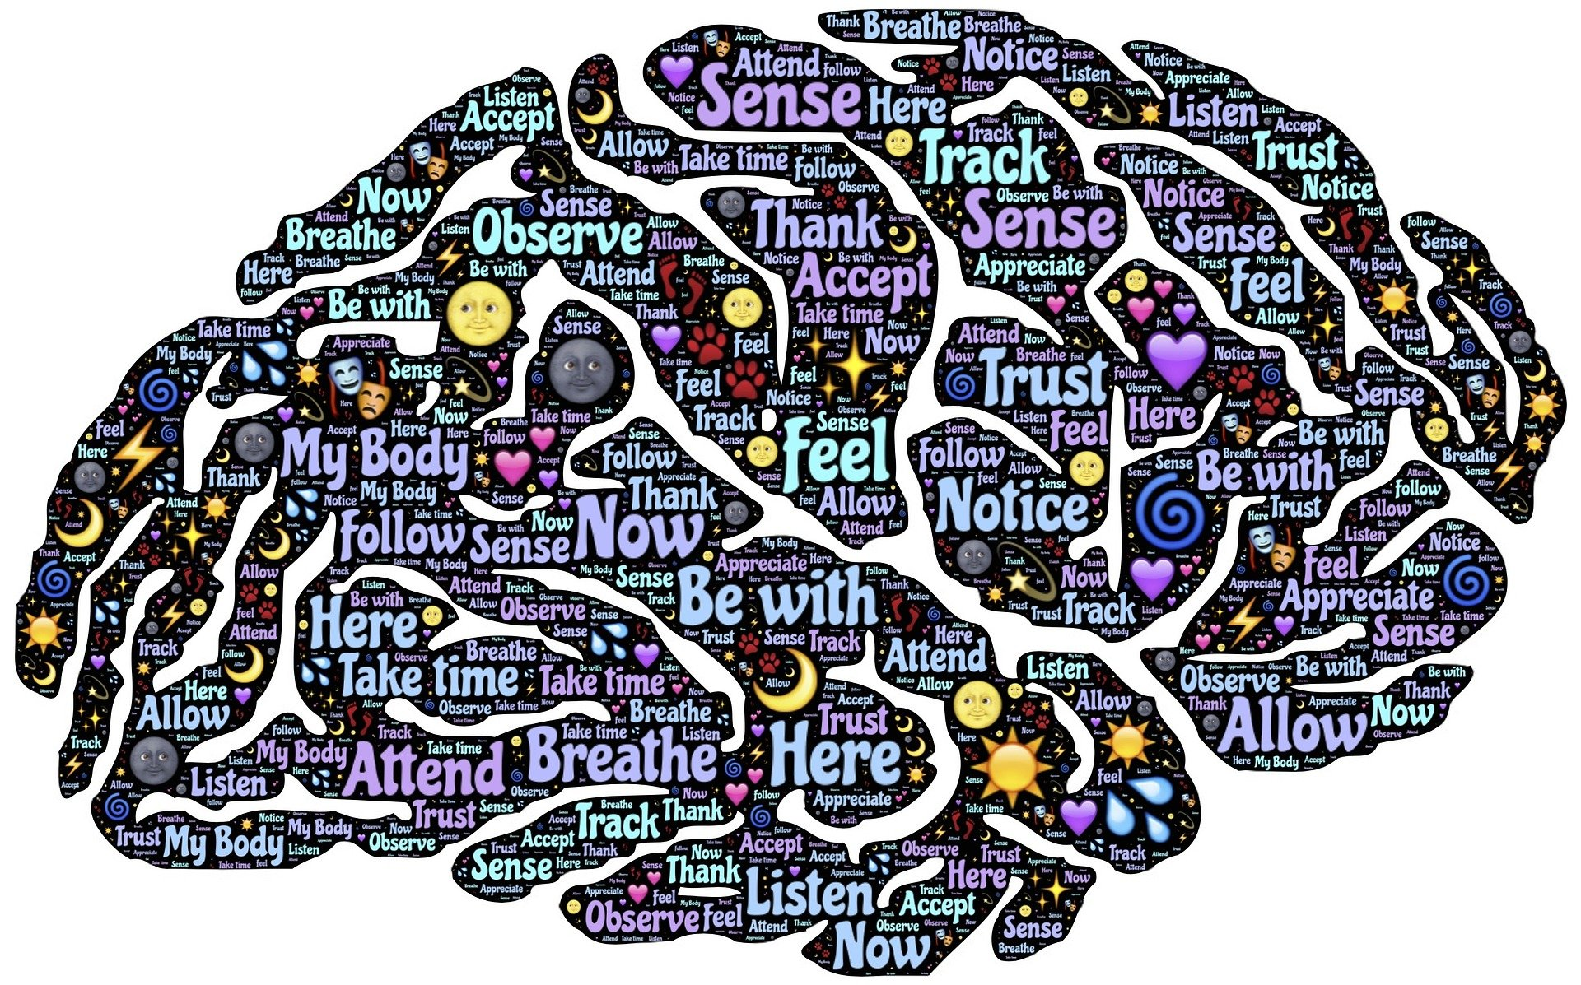
What Emotions are?
Emotions are reactions that human beings experience in response to events or situations. The type of emotion a person experiences is determined by the circumstance that triggers the emotion. For instance, a person experiences joy when they receive good news. A person experiences fear when they are threatened.
Emotions have a strong influence on our daily lives. We make decisions based on whether we are happy, angry, sad, bored, or frustrated. We choose activities and hobbies based on the emotions they incite. Understanding emotions can help us navigate life with greater ease and stability.

Slide 3
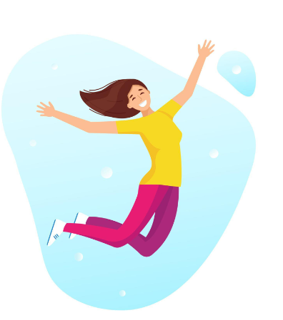
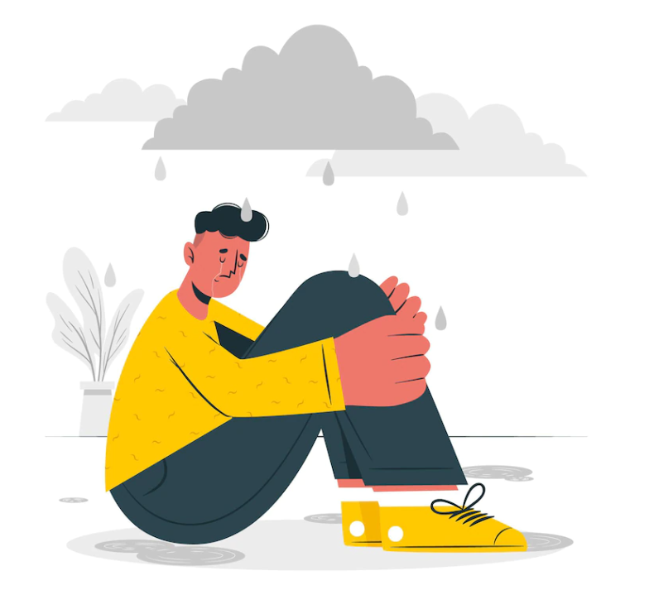
6 Kinds of emotions
Happiness
Pleasant emotion, a sign of happines is a smile or laugh, it is a reaction to some accomplishment or it is a reaction to true love, some symptoms are increased heart rate, higher blood preassure
Sadness
Opposite of happines, strong emotion, if you cannot cope with sadness it can lead to depression, some symptoms are insomnia, eating disorder, from biological point of view sadness is a form of calling for help

Slide 4
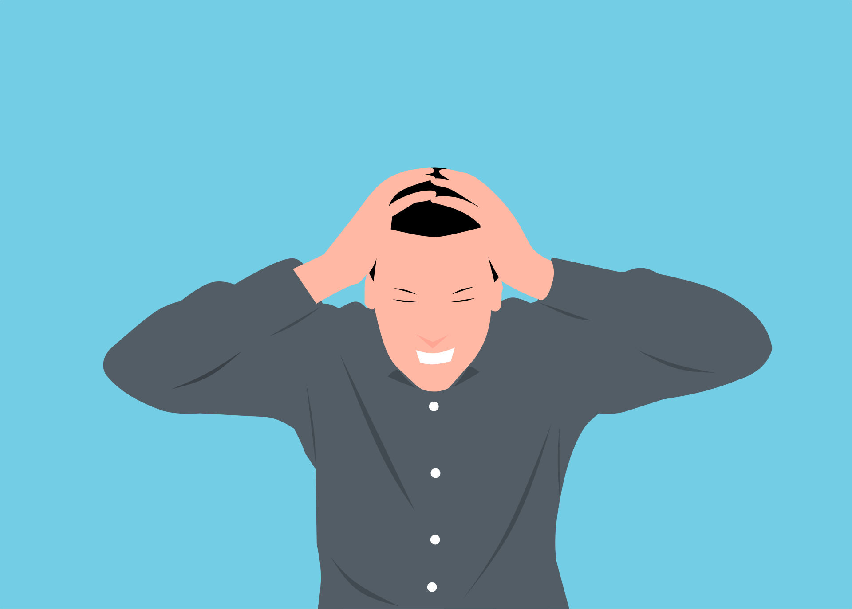
Anger
Really strong emotion, it prepares you to fight, some physiologic symptoms are redness in face, sweating, higher blood preassure, increased heart rate, it can destroy your relationships, is tough to master the breathing techniques used to Relax your body.
Fear
Reaction to some danger, symptoms are fast breathing, goosebumps, high heart rate, paleness, shivering, the purpose is to prepare you to escape, if there is no room for escape, fear can become agression, fear can be used to control masses.

Slide 5
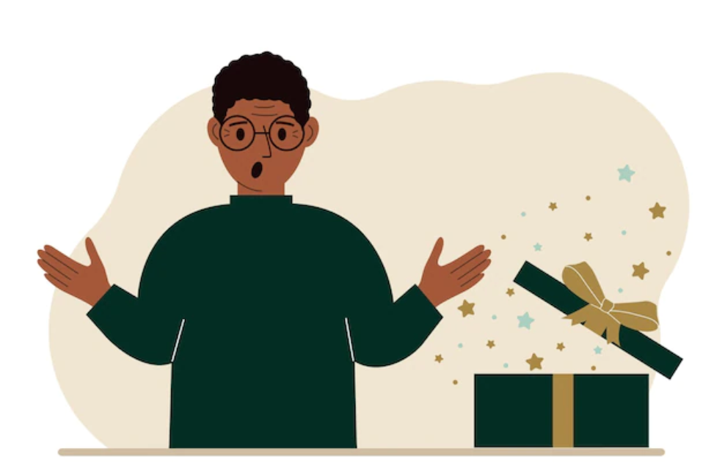
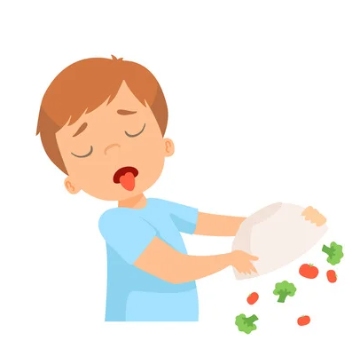
Surprise
Surprise is usually quite brief and is characterized by a physiological startle response following something unexpected. This type of emotion can be positive, negative, or neutral. An unpleasant surprise, for example, might involve someone jumping out from behind a tree and scaring you as you walk to your car at night.
Disgust
You typically experience disgust as a reaction to unpleasant or unwanted situations. Like anger, feelings of disgust can help protect you from things you want to avoid. It can also pose problems if it leads you to dislike certain people, including yourself, or situations that aren’t necessarily bad for you.

Slide 6
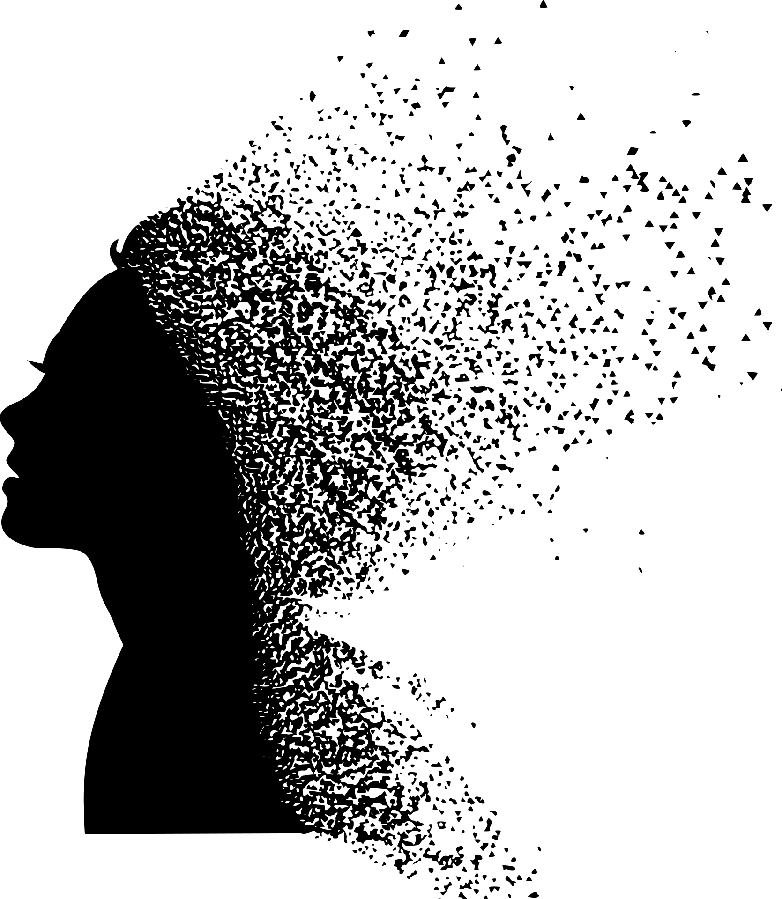

What if we are lack of emotions?
Emotional numbness can leave you feeling detached from friends and family, you might lose interest in the activities that once brought you joy and, because you feel flat, you might find it difficult to fully participate in life. Simply put, it's when you shut out or struggle to feel your feelings.

Slide 7

How to control your emotions?
Take a look at the impact of your emotions
Aim for the regulation, not repression
Identify what you’re feeling
Accept your emotions – all of tchem
Keep a mood journal

Slide 8
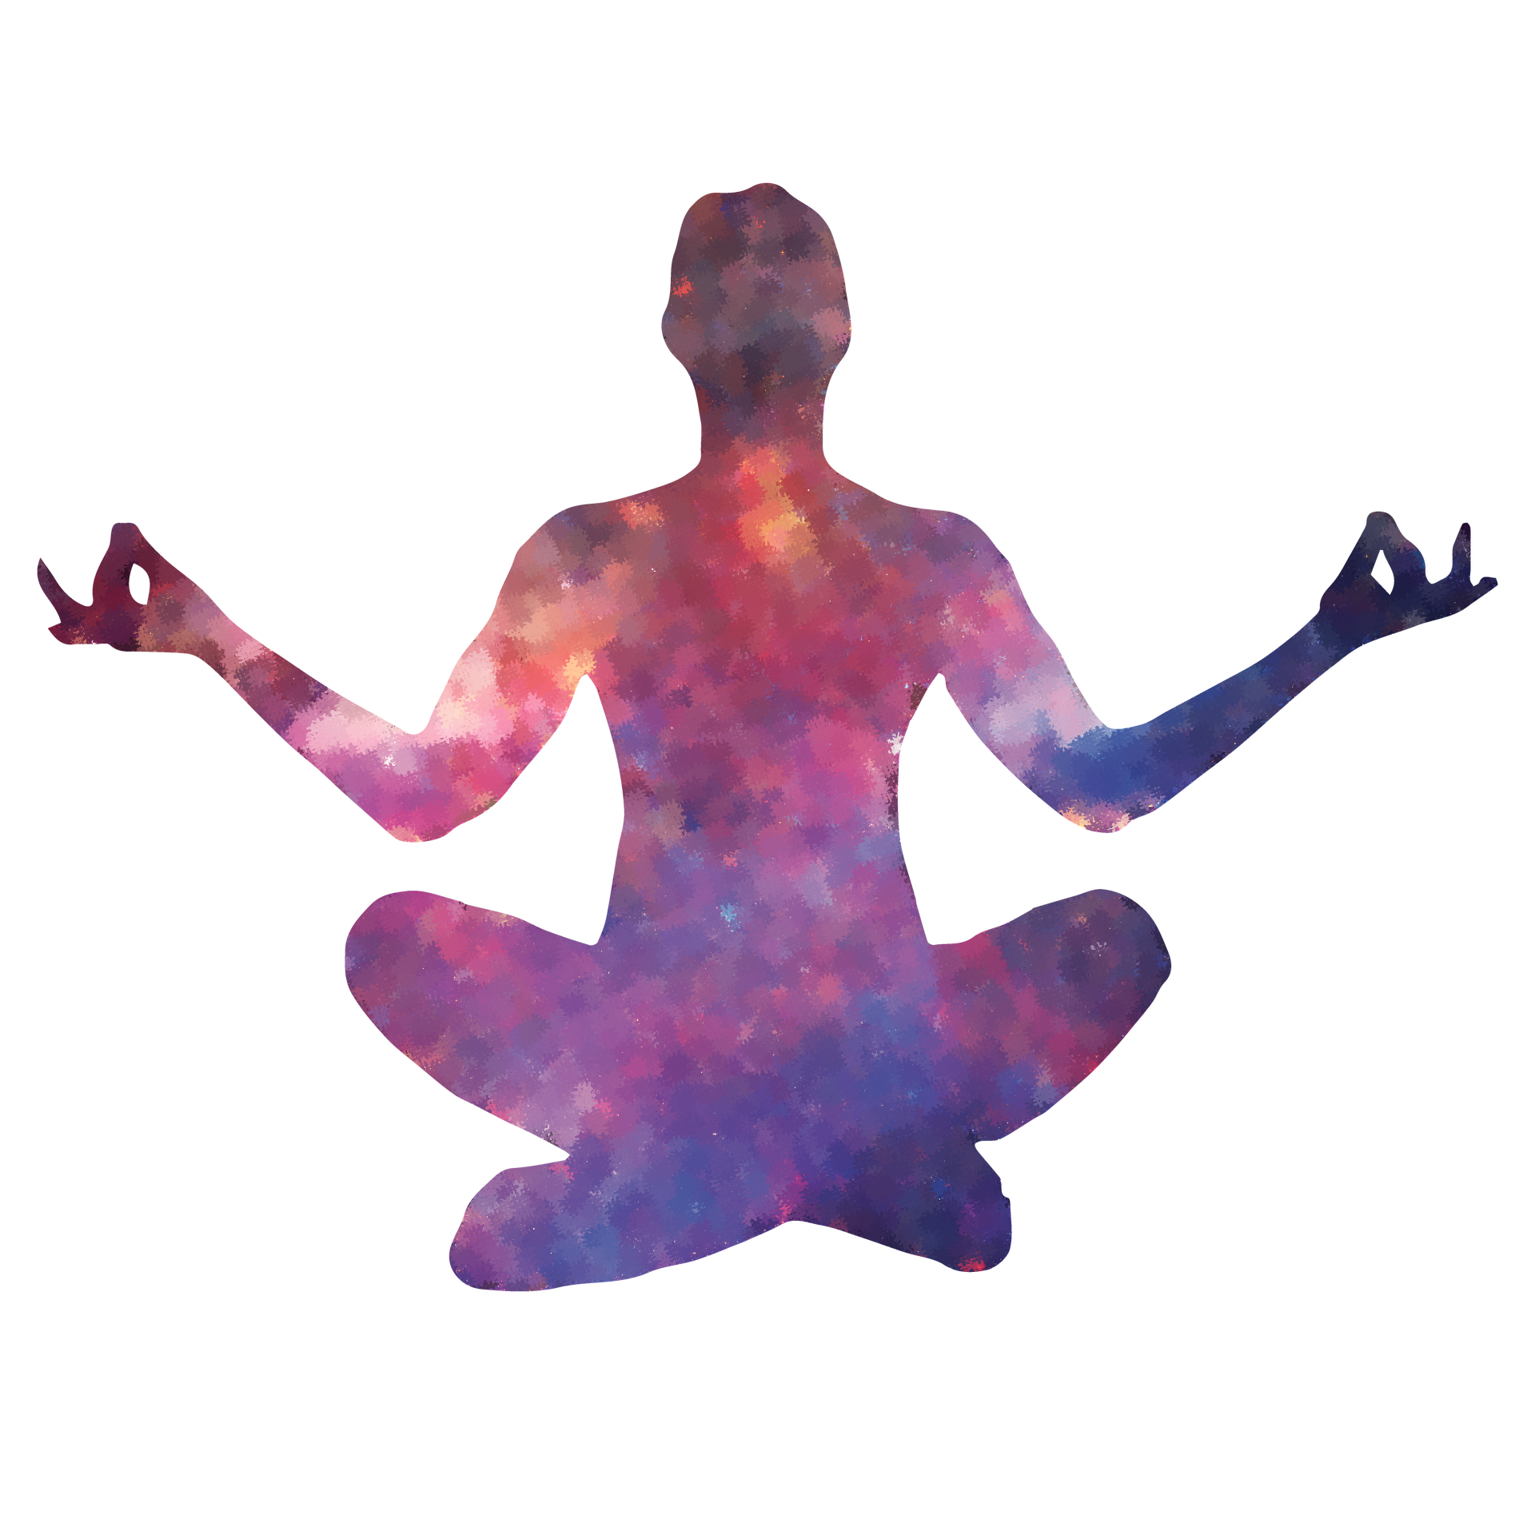
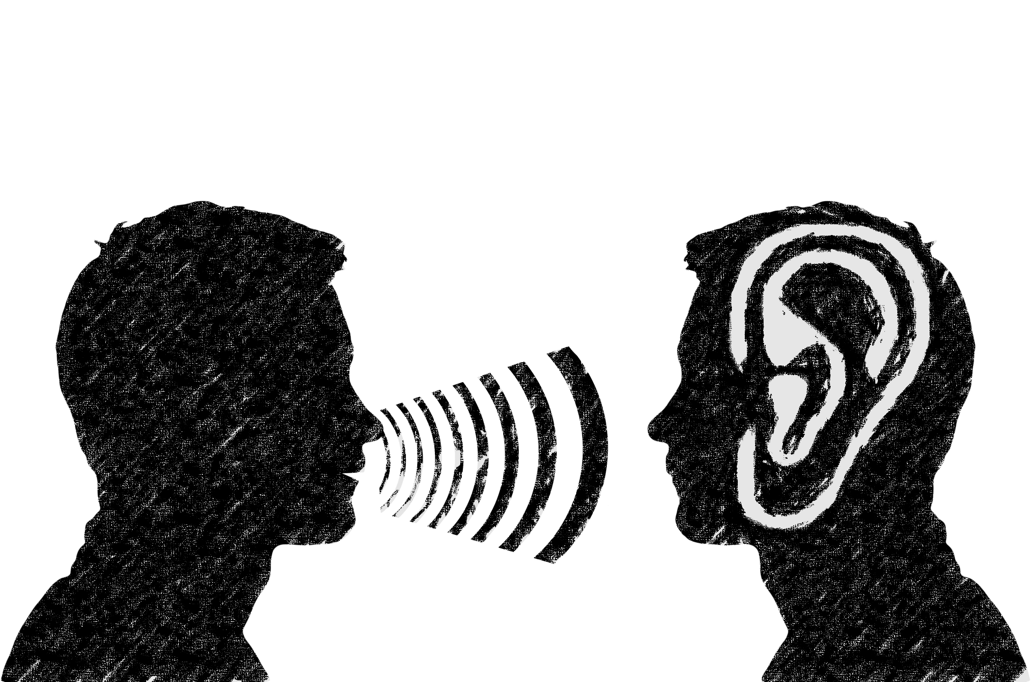
Know when to express yourself
Give yourself some space,
Try meditation
Stay on top of stress
Talk to a therapist

Slide 9

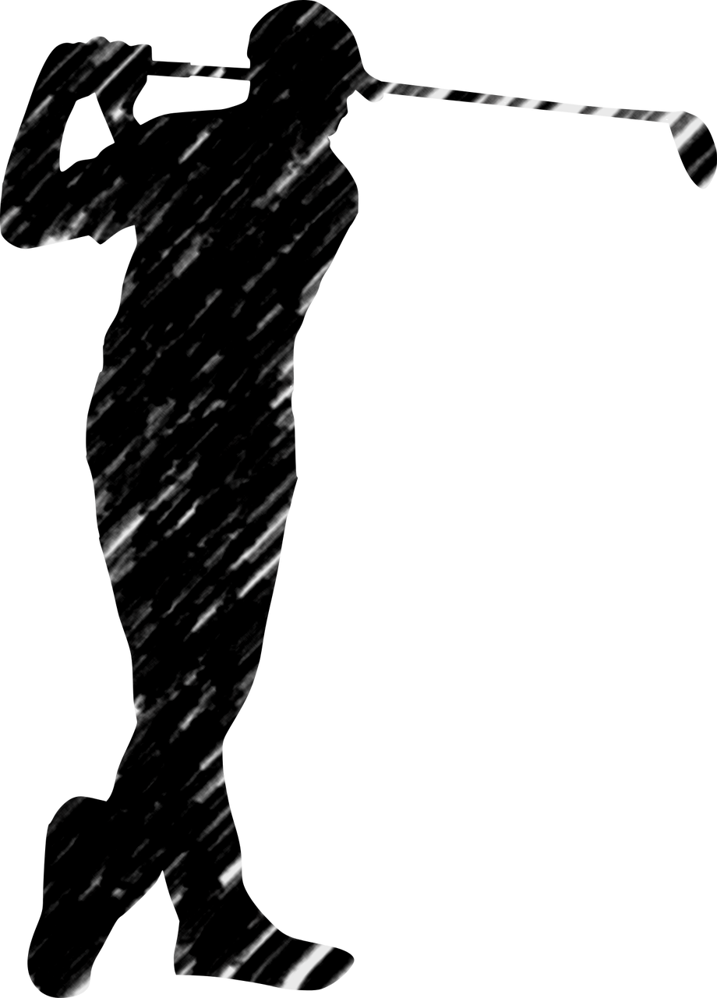
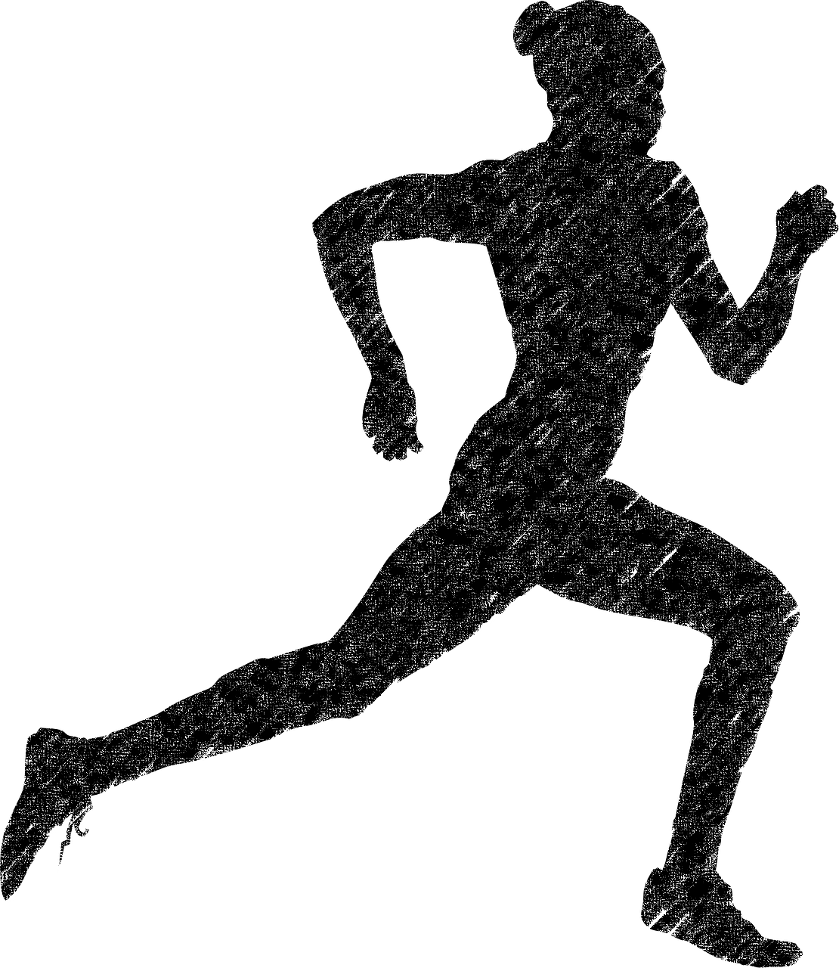
Healthy ways to cope with stress include
Getting enough sleep
Exercise
Spending time in nature
Making time for relaxtion and hobbies

Slide 10

Questions AT THE END
  What do you do to stress out?
  When emotions are a problem?
  What activates emotions?
  What are emotions for?
  What makes you feel sad?

Slide 11
Thank you for your attention
Presentation was made by:
Jonasz Jęcz
Zosia Żak
Wiktoria Gołąbka
Urszula Kowal
Zdedna Volf
Benedikt Pánek
Jim Xavrouzas
Stefanos Argiris

