Slide 1
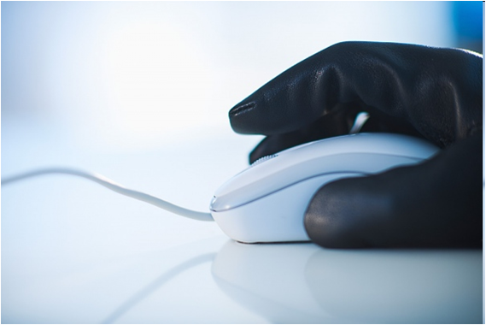
The dangers of virtual communication
por. Bc. Milan Bajcura
The department of press and prevention of the Regional directorate of police of the South Bohemian region
Oddělení tisku a prevence Krajského ředitelství policie Jihočeského kraje

Slide 2

Essential concepts
Cyberbully
Cybergrooming
Cyberstalking
Sexting
Social networks

Slide 3

Cyberbully
=taking advantage/misuse of communicaton technology, more specifically mobile phones and the internet, in order to intentionally throw someone out of balance
Tools mostly used for cyberbullying:
68 % mobile phones
57 % social networks
29 % e-mail
14 % chat

Slide 4
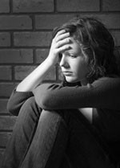
Statistics
46,8 % children have been victims of one of the forms of cyberbullying
27,8 % children have been originators of one of the forms of cyberbullying
Less than 30% of children would confess cyberbullying to their parents.
Girls are the victims in most of the cases.

Slide 5
How does cyberattack look?
Provoking by sending a message with vulgar and insulting content
Harassment and stalking
Slander/gossip in online environment
Notes:
Andrea a Silvie byly nejlepší kamarádky. Když si Silvie našla jinou nejlepší kamarádku a s Andreou už se nechtěla bavit, Andrea se rozhodla, že se jí pomstí. Koupila si novou SIM kartu a každý večer od 22:00 do 23:00 hodin Silvii prozváněla na mobilní telefon. Každých 5 minut... Noční telefony budily nejen Silvii, ale také její rodiče, kteří na ni za to byli hodně naštvaní. Mysleli si, že si Silvie s někým tajně v noci volá a že jim o tom lže. Silvie z toho měla velké problémy. Aby prozvánění zastavila, musela si nakonec pořídit jinou SIM kartu.
Robert vytvořil internetové stránky s názvem „Nesnášíme Tomáše Černého“. Na stránky umisťoval Tomášovy karikatury, vtipy o Tomášovi, pomluvy
a ponižující ankety. Na existenci stránek upozornil většinu svých kamarádů. Ti začali v rámci diskuze Tomáše nevybíravým způsobem hodnotit a dál ponižovat. O této stránce se brzy dozvěděl také Tomáš.

Slide 6
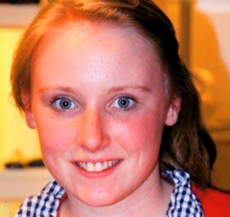
cases of cyberbully
Holly Grogan (15 years old, GB, september 2009)
Holly was bullied by her classmates in a catholic school. She was lonely and her only desire was to find friends. Her confidence was very low, so she created an account on Facebook. Instead of getting new friends, she became a target of insults and abuse because many of her classmates had slandered her on the network. She was left with abusive comments, which could have been read by anyone.
Consequence: Holly commited a suicide by jumping of the bridge
Article:
http://www.super.cz/7053-to-neni-pekny-pohled-mlada-britka-se-kvuli-sikane-stala-anorektickou-vazila-30-kilo-a-jeji-zivot-visel-na-vlasku.html
http://www.novinky.cz/zahranicni/evropa/294246-devitilety-brit-se-obesil-kvuli-sikane-tyrali-ho-ze-byl-bily.html

Slide 7
How can you defend yourself?
BRING IT TO AN END
  Do no communicate with the attacker
BLOCK THE ATTACKER
  Denny acces to the attacker
  Change your virtual identity
IDENTIFY THE ATTACKER
REPORT
  To an adult or the authorities (police)
If witness cyberbully in your surrungings,
don´t be ignorant.
Support the victim and advise them of what to do.
Notes:
2. (zablokovat si přijímání útočníkových zpráv či hovorů, kontaktovat poskytovatele služby),
3. - pokud je to možné (např. podle profilu)
4. schovat si důkazy pro vyšetřování

Slide 8
Where to find help?
Bezpečně-online.cz
www.bezpecne-online.cz
Horkálinka.cz
http://horka-linka.saferinternet.cz/
Seznam se bezpečně 1 a 2
http://www.seznamsebezpecne.cz/
Pomoc online (Internet Helpline)
www.pomoconline.cz
116 111, 800 155 155
E-Bezpečí
www.e-bezpeci.cz
www.napisnam.cz
Národní centrum bezpečnějšího
internetu (Safer Internet)
www.saferinternet.cz
Video: http://tn.nova.cz/bin/search_adv_media_desc.php?media_id=692560

Slide 9
Cyberbully and law
Violence against group of individuals and against an individual (§ 352 TZ, až 1 rok)
slander (§ 184 TZ, až 1 rok),
Restriction of personal freedom (§ 171 TZ, až 2 roky),
Blackmail (§ 175 TZ, 6 měs. až 4 roky),
Dangerous threats (§ 353 TZ, až 1 rok),
Dangerous stalking (§ 354 TZ, až 1 rok),
Fraud (§ 209 TZ, až 2 roky),
Damage to another´s property (§ 228 TZ, až 1 rok),
Theft (§ 205 TZ, až 2 roky),
Harm (§ 146 TZ, 6 měs. až 3 roky).
http://www.novinky.cz/krimi/293682-za-nabourani-do-facebookoveho-profilu-hrozi-zene-z-plzne-dva-roky.html

Slide 10
Cybergrooming
= act of the manipulator (groomer), which should gain child´s fake trust to lure him out for a meeting in order to cause the kid harm
The attacker uses social networks, chat, Skype or SMS messages to communicate with the victim.
Every 5. child in Europe, which chatts, is contacted by groomer.

Slide 11
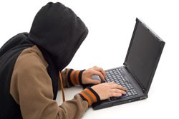
How does A groomer act?
Gaining trust, pursuit of isolating the victim
(a groomer gains for example the phone number, a photo)
Bribery with gifts (money, phone…) building a friendly relationship
Causing emotional addiction to the groomer (groomer knows victim´s secrets – tool for blackmail)
Personal meating
Victim abuse
(sexual harassment, abuse)

Slide 12
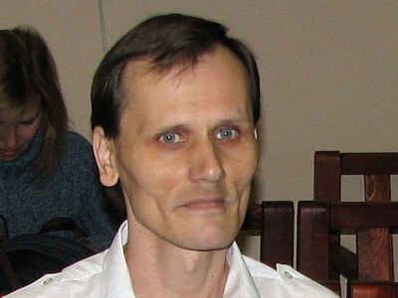
cybergrooming case
Pavel Hovorka
Pavel Hovorka, the porter in the prague´s printerrs,
was in 2008 sentenced for sexual abuse,
blackmail and sexual seduction – 20 boys (he forced 8 of them for sexual intercourse). His sentence was 6.5 years- in prison (commuted from original 8 years).
He was luring his victims to fictitious Kids VIP contest, where he promised- that they´re going to spend 2 weeks in Prague and win interesting prizes. He was meeting the kinds on the internet (Lide.cz), manipulating them little by little, acquiring photos with which he then proceeded to blackmail them.

Slide 13
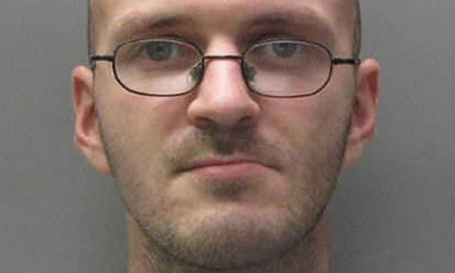
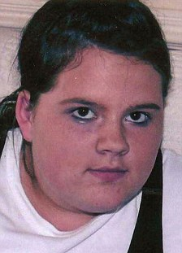
Cybergrooming case
Peter Chapman (Great Britain)
Was sentenced in 2010 to life imprisonment
for rape and a murder.
Ashleigh Hall, a nursing student, acquinted herself on Facebook with „16 years old“ boy. After longer communication they arranged a meeting together. However she didn´t return home. To her murder confessed 32 years old Peter Chapman, previously convicted of sexual offenses. He raped and strangled the girl.
After releasing the case, another girls with whom Chapman also communicated began to contact the police.

Slide 14
How to defend yourself?
1. Do not let yourself be deceived with promises of virtual attacker. Realize, that poeple on the internet might be lying.
2. Notice discrepancies in the communication with groomers.
3. Realize, why would anyone want to keep the internet relationship or the content of the communication a secret, no matter the costs.
4. Set your personal boundaries when it comes to sex. Don´t accept or send content of sexual nature to other users.
5.Do not share your personal information with no one in the virtual environment.
6. Never attend a personal meeting without your parent´s knowledge.
7. You can never know, who is on the other side.
Notes:
(mohou vám slibovat lásku, peníze, dárky apod.).
(útočník například udává různý věk, mění informace, které vám o sobě sdělil dříve apod.).
5. (zejména nikomu neposílejte své fotografie).
6. Uvědomte si, co všechno se vám na schůzce může stát a jak může být schůzka riskantní.
7. Internetová komunikace vypadá jako anonymní, ale není. Nechcete přece, aby vás „internetový známý“ např. vystopoval v reálném světě, nebo aby vás nutil dělat něco, co dělat nechcete.

Slide 15
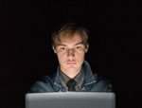
Cyberstalking
= using the internet, mobile phones and other information
or communication devices for stalking
Stalking
= continued pursuit and harassment
In theCzech Republic cca 10 % of people have encountered stalking.
2 % of the cases of stalking result in death.
14,6 % of people in Czech Republic under 18 years old have experienced stalking.
(research E-Security, 2021).
Stalking is a felony in the Czech Republic. (from 1 Jan 2010).

Slide 16
How does stalking look?
Repeated long-term attempts to contact the victim.
(using chat, telephone, SMS messages, sending packets with gifts, etc.).
Demonstration of power and strenght of the stalker.
(threats).
Destroying victim´s property(for example. Destroying windows, car, sending a computer virus etc.), hurting victim´s relatives, pets or hurting the victim itself

Slide 17
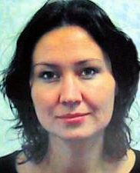
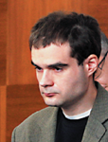
Case of stalking
Sadistic stalker Petr Hanuš had been stalking his collegue Michaela Maličková (33) for over than 2 years. He had been sending her threatening emails, SMS messages, spying on her, physically attacking her and he destroyed her car.
He was sentenced to 250 hours of community service. For not fufilling them, the sentence was changed to 1.25 days in prison. Hanuš postponed the start of his sentence due to bad mental condition.
Consequence:
He beat her in font of her house
with a four kilo branch.
He was sentenced to 15 years in prison.
.
Video Romana Schuppanová (12:54):
http://www.ceskatelevize.cz/ivysilani/210542151210001-stalking/

Slide 18
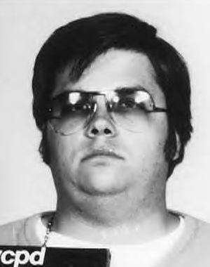
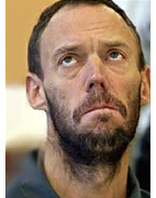
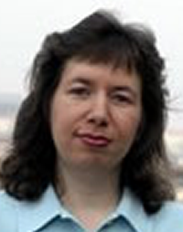
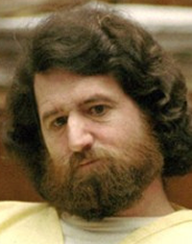
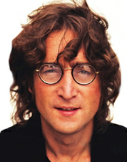
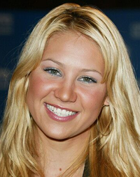
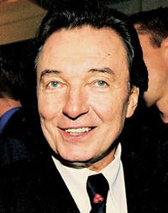
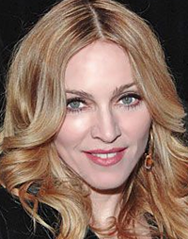
Stalkers of celebrities
John Lennon Anna Kurnikovová
Karel Gott Madonna
Notes:
Mark David Chapman J. Lennona zavraždil 8. prosince 1980 v New Yorku. Za tuto vraždu byl odsouzen na doživotí.
bezdomovec William Lepeska. Poslal jí několik dopisů a množství e-mailů. Z obavy o svou bezpečnost si Ruska najala i osobního strážce. Lepeska byl nakonec zatčen v lednu 2005. nahý přeplaval zátoku Biscayne Bay směrem k rezidenci Kurnikovové v Miami. Její vilu však nepoznal, a tak se omylem zjevil u bazénu sousedů, kde začal hulákat: „Anno, zachraň mě.“
Němka Hannelore Uhl (47 let) pronásleduje Karla Gotta už skoro třicet let. Její úsilí ale stále nepolevuje. Každý den od ní Gottovi chodí dopisy, které mají pět až šest stran. V nich vyhrožuje, že zlikviduje celou jeho rodinu.
Madonna odmítla zájem svého fanouška Roberta Dewey Hoskinse (42 let) i jeho návrhy k sňatku nebo jeho pokusy nastěhovat se k ní domů, opakovaně jí vyhrožoval smrtí. Sliboval, že „když se za něj neprovdá, podřízne jí hrdlo od ucha k uchu“. pronásledoval, 5krát na ni zaútočil. Byl odsouzen k 10letému vězení.

Slide 19
How to defend oneself?
1. Cut off personal contacts with the stalker
(don´t answer the calls, don´t respond to their messages)
2. Avoid places of possible encounter, change your habits.
3. Save threatening chats, SMS and emails(=save evidence for the police).
4. Outside of home move with another person – member of the familly or another trustworthy person
5. Carry legal means of defense with yourself (pepper spray). Carry a mobile phone in case you need to call for help.

Slide 20


How to defend oneself?
6. Do not share your personal information!!!
7. Find help - contact for example
Bílý kruh bezpečí (www.bkb.cz)
Policie ČR na lince 158

Slide 21
Sexting
Sending electronic messages, photos or videos with sexual content.
Those (photos, videos) can be later shared on the internet – especially when the relationship between those persons comes to an end.

Slide 22
Risks of sexting
You give potential attacker a sensitive content, which can be later used against you (for ex. for cyberbullying, blackmail or sexual assault)
This content can circle around the internet for many years (even years after its origin).
The loss of prestige, which goes hand in hand with struggles with getting and maintaing a job or social relations
You may become a perpetrator of misdemeanor or a crime (sharing child pronography etc.).

Slide 23

legal paradox
Individual over 15 is alowed to have sex (they don´t commit a crime).
However,they cannot photograph themselves, film themsels or write a journal while doing so (if they aren´ t over 18 years old)
Then it could be considered as a production and possesion of child pornography.

Slide 24
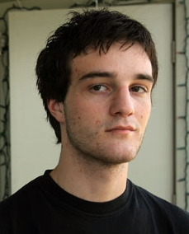
Case of sexting
The known case of sexting represents the case of
Filip Apert, Florida. Without him
asking, his 16 year old girlfriend sent him photos
on which she was fully naked. After they had
broken up, Philip sent those photos to his friends and to the girl´s parents
(more than 70 people).
Consequence: He was sentenced to 5 years on probation for sharing child pornography (probation supervision) and he will be on the register of sexual assaulters (in which are sexual assaulters, deviants, who harassed minors etc. are registered) until he reaches 43 years .
Link Say no https://www.youtube.com/watch?v=UKvnhqSOr4g

Slide 25
Preventive advice
Preventive project
TO NEVYMAŽEŠ (YOU CAN´T ERASE THAT) – www.tonevymazes.cz

Slide 26
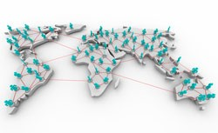
SociAL nETWORKS
= information networks provided by internet portals
They allow:
- Creating a virtual community
- Sharing photos, videos or personal information with others
- Chatting with anyone
Cca 3 billion users use social networks worldwide,
a third of the human population.
Mostly people at the age of 15 – 24 .
Which networks do you know?

Slide 27






Examples of social networks
http://www.stream.cz/video/547448-facebook-podivejte-se-na-nejvetsi-rekordy-a-zvracenosti

Slide 28
Danger of social networks
Everything what you put on social networks, can be easily downloaded by many people and even after a few years they might use it against you.
Even a stranger can create a perfect picture of you, based on your profile on social networks.
Think about your future job while posting online.
Notes:
Nemusí tě ani jednou vidět, přitom toho může vědět hodně: jak vypadáš, kde bydlíš, kam chodíš do školy nebo s kým se kamarádíš. A to, že takové věci se dají hodně snadno zneužít, je ti určitě jasné.
Třeba máš tajný sen o nějakém zajímavém pracovním místě a lidé, kteří důležité pracovníky vybírají, si už dneska všímají i soukromých profilů v sociálních sítích. Proto ti obsah tvé profilové stránky, to, jak se sám popisuješ nebo to, k jaké internetové skupině se hlásíš, může ovlivnit například tvé přijetí či nepřijetí do práce.…(např. se přihlásíš do skupiny Nečtu knihy, Mám rád noční život – pařby, kluby, diskotéky…neudělá si o vás hezký obrázek)

Slide 29
Useful tips for your safety
Don´t share your contact information in your profile.
Read the terms of use and conditions for the protection of your personal data: who can dig my personal data?
Be careful with profile settings: what am I allowing to someone to learn about me?
It is mportant the use of a nickname.

Slide 30
Thank you for your attention!
por. Bc. Milan Bajcura
The department of press and prevention
The Regional Directorate of Police of the South Bohemian
2 Dvořákova st.
České Budějovice
Phone: +420 974 221 722
Email: krpc.pio@pcr.cz

